Slide 1
/LEARNING PYTHON
YOUR LOGO HERE
4110E231 柯立丹
INDEX.HTML

Slide 2
/CONTENTS
/01
/WHAT IS PYTHON
/02
/PYTHON JOBS
/03
/WHY TO LEARN PYTHON?
/04
/PYTHON ONLINE
YOUR LOGO HERE
/05
/GOOGLE COLAB
/06
/YOUR PYTHON CODE
INDEX.HTML

Slide 3
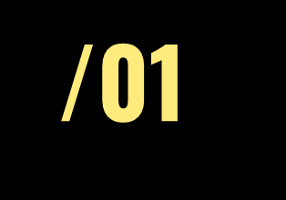
<WHAT IS PYTHON>
INDEX.HTML

Slide 4
/CONTENTS OF THIS TEMPLATE
YOUR LOGO HERE
Here’s what you’ll find in this Slidesgo template:
A slide structure based on a workshop, which you can easily adapt to your needs. For more info on how to edit the template, please visit Slidesgo School or read our FAQs.
To view this template in PowerPoint with the correct fonts, download and install on your computer the fonts that we have used. You can learn how to download and install fonts here.
An assortment of graphic resources that are suitable for use in the presentation can be found in the alternative resources slides.
A thanks slide, which you must keep so that proper credits for our design are given.
A resources slide, where you’ll find links to all the elements used in the template.
Instructions for use.
Final slides with:
The fonts and colors used in the template.
A selection of illustrations. You can also customize and animate them as you wish with the online editor. Visit Storyset to find more.
More infographic resources, whose size and color can be edited.
Sets of customizable icons of the following themes: general, business, avatar, creative process, education, help & support, medical, nature, performing arts, SEO & marketing, and teamwork.
You can delete this slide when you’re done editing the presentation.
INDEX.HTML

Slide 5
/WHAT IS PYTHON
YOUR LOGO HERE
Python is a very popular general-purpose interpreted, interactive, object-oriented, and high-level programming language. Python is dynamically-typed and garbage-collected programming language. It was created by Guido van Rossum during 1985- 1990. Like Perl, Python source code is also available under the GNU General Public License (GPL).
Python supports multiple programming paradigms, including Procedural, Object Oriented and Functional programming language. Python design philosophy emphasizes code readability with the use of significant indentation.
This tutorial gives a complete understanding of Python programming language starting from basic concepts to advanced concepts. This tutorial will take you through simple and practical approaches while learning Python Programming language.
INDEX.HTML

Slide 6
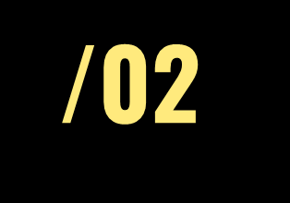
<PYTHON JOBS>
INDEX.HTML

Slide 7
/PYTHON JOBS
YOUR LOGO HERE
Today, Python is very high in demand and all the major companies are looking for great Python Programmers to develop websites, software components, and applications or to work with Data Science, AI, and ML technologies. When we are developing this tutorial in 2022, there is a high shortage of Python Programmers where as market demands more number of Python Programmers due to it's application in Machine Learning, Artificial Intelligence etc.
Today a Python Programmer with 3-5 years of experience is asking for around $150,000 annual package and this is the most demanding programming language in America. Though it can vary depending on the location of the Job. It's impossible to list all of the companies using Python, to name a few big companies are:
Google
Intel
NASA
PayPal
Facebook
IBM
Amazon
Netflix
Pinterest
Uber
Many more...
INDEX.HTML

Slide 8
/PYTHON JOBS
YOUR LOGO HERE
So, you could be the next potential employee for any of these major companies. We have developed a great learning material for you to learn Python Programming which will help you prepare for the technical interviews and certification exams based on Python. So, start learning Python using this simple and effective tutorial from anywhere and anytime absolutely at your pace.
INDEX.HTML

Slide 9
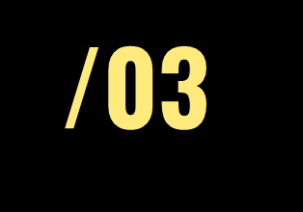
<WHY LEARN PYTHON>
INDEX.HTML

Slide 10
/WHY TO LEARN PYTHON
YOUR LOGO HERE
Python is a very popular general-purpose interpreted, interactive, Python is consistently rated as one of the world's most popular programming languages. Python is fairly easy to learn, so if you are starting to learn any programming language then Python could be your great choice. Today various Schools, Colleges and Universities are teaching Python as their primary programming language. There are many other good reasons which makes Python as the top choice of any programmer:
Python is Open Source which means its available free of cost.
Python is simple and so easy to learn
Python is versatile and can be used to create many different things.
Python has powerful development libraries include AI, ML etc.
Python is much in demand and ensures high salary
INDEX.HTML

Slide 11
/WHY TO LEARN PYTHON
YOUR LOGO HERE
Python is a MUST for students and working professionals to become a great Software Engineer specially when they are working in Web Development Domain. I will list down some of the key advantages of learning Python:
Python is Interpreted − Python is processed at runtime by the interpreter. You do not need to compile your program before executing it. This is similar to PERL and PHP.
Python is Interactive − You can actually sit at a Python prompt and interact with the interpreter directly to write your programs.
Python is Object-Oriented − Python supports Object-Oriented style or technique of programming that encapsulates code within objects.
Python is a Beginner's Language − Python is a great language for the beginner-level programmers and supports the development of a wide range of applications from simple text processing to WWW browsers to games.
INDEX.HTML

Slide 12
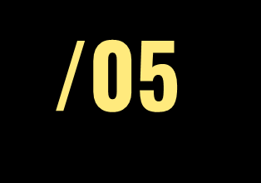
<Python Online Compiler/Interpreter>
INDEX.HTML

Slide 13
/ONLINE COMPILER/INTERPRETER
YOUR LOGO HERE
We have provided Python Online Compiler/Interpreter which helps you to Edit and Execute the code directly from your browser. JUST CLICK HERE: 1. Choice One
2. Choice Two
INDEX.HTML

Slide 14
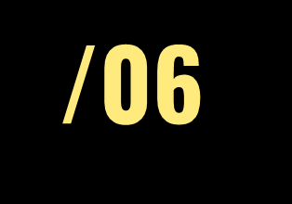
<GOOGLE COLLAB>
INDEX.HTML

Slide 15
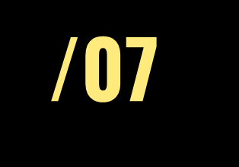
<PYTHON CODE>
INDEX.HTML

